Slide 1

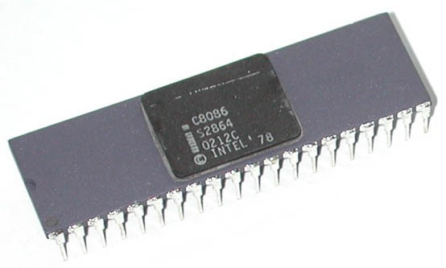
Intel 8086 was launched in 1978.
It was the first 16-bit microprocessor.
 This microprocessor had major improvement over the execution speed of 8085.
It is available as 40-pin Dual-Inline-Package (DIP).

Slide 2
It is available in three versions:
▪ 8086 (5 MHz)
▪ 8086-2 (8 MHz)
▪ 8086-1 (10 MHz)
It consists of 29,000 transistors.

Slide 3
It has a 16 line data bus.
And 20 line address bus.
It could address up to 1 MB of memory.
It has more than 20,000 instructions.
It supports multiplication and division.

Slide 4

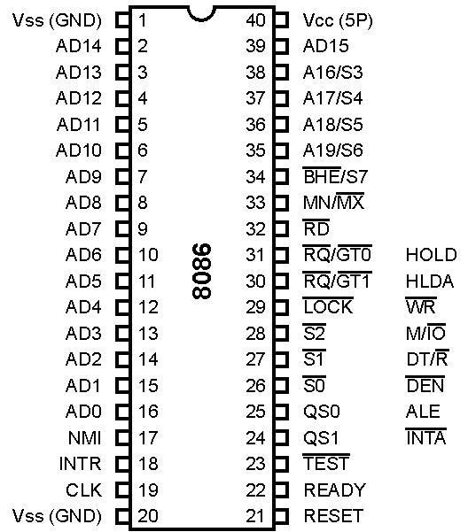

Slide 5

 These lines are multiplexed bi- directional address/data bus.
 During T₁, they carry lower order 16-bit address.
In the remaining clock cycles, they carry 16-bit data.
 AD₀-AD₇ carry lower order byte of data.
 AD₈-AD₁₅ carry higher order byte of data.

Slide 6

These lines are multiplexed unidirectional address and status bus.
During T₁, they carry higher order 4-bit address.
In the remaining clock cycles, they carry status signals.

Slide 7

BHE stands for Bus High Enable.
BHE signal is used to indicate the transfer of data over higher order data bus (D₈ – D₁₅).
8-bit I/O devices use this signal.
It is multiplexed with status pin S₇.

Slide 8

It is a read signal used for read operation.
It is an output signal.
It is an active low signal.

Slide 9

This is an acknowledgement signal from slower I/O devices or memory.
It is an active high signal.
When high, it indicates that the device is ready to transfer data.
When low, then microprocessor is in wait state.

Slide 10

It is a system reset.
It is an active high signal.
When high, microprocessor enters into reset state and terminates the current activity.
It must be active for at least four clock cycles to reset the microprocessor.

Slide 11

It is an interrupt request signal.
It is active high.
It is level triggered.

Slide 12

It is a non-maskable interrupt signal.
It is an active high.
It is an edge triggered interrupt.

Slide 13

It is used to test the status of math co- processor 8087.
The BUSY pin of 8087 is connected to this pin of 8086.
If low, execution continues else microprocessor is in wait state.

Slide 14

This clock input provides the basic timing for processor operation.
It is symmetric square wave with 33% duty cycle.
The range of frequency of different versions is 5 MHz, 8 MHz and 10 MHz.

Slide 15

V_{CC} is power supply signal.
+5V DC is supplied through this pin.
V_{SS} is ground signal.

Slide 16

8086 works in two modes:
Minimum Mode
Maximum Mode
If MN/MX is high, it works in minimum mode.
If MN/MX is low, it works in maximum mode.

Slide 17
Pins 24 to 31 issue two different sets of signals.
One set of signals is issued when CPU operates in minimum mode.
Other set of signals is issued when CPU operates in maximum mode.

Slide 18


Slide 19

This is an interrupt acknowledge signal.
When microprocessor receives INTR signal, it acknowledges the interrupt by generating this signal.
It is an active low signal.

Slide 20

This is an Address Latch Enable signal.
It indicates that valid address is available on bus AD₀ – AD₁₅.
It is an active high signal and remains high during T₁ state.
It is connected to enable pin of latch 8282.

Slide 21

This is a Data Enable signal.
This signal is used to enable the transceiver 8286.
Transceiver is used to separate the data from the address/data bus.
It is an active low signal.

Slide 22

This is a Data Transmit/Receive signal.
It decides the direction of data flow through the transceiver.
When it is high, data is transmitted out.
When it is low, data is received in.

Slide 23

This signal is issued by the microprocessor to distinguish memory access from I/O access.
When it is high, memory is accessed.
When it is low, I/O devices are accessed.

Slide 24

It is a Write signal.
It is used to write data in memory or output device depending on the status of
M/IO signal.
It is an active low signal.

Slide 25

It is a Hold Acknowledge signal.
It is issued after receiving the HOLD signal.
It is an active high signal.

Slide 26

When DMA controller needs to use address/data bus, it sends a request to the CPU through this pin.
It is an active high signal.
When microprocessor receives HOLD signal, it issues HLDA signal to the DMA controller.

Slide 27


Slide 28

These pins provide the status of instruction queue.
QS₁ | QS₀ | Status
0 | 0 | No operation
0 | 1 | 1st byte of opcode from queue
1 | 0 | Empty queue
1 | 1 | Subsequent byte from queue

Slide 29

These status signals indicate the operation being done by the microprocessor.
This information is required by the Bus Controller 8288.
Bus controller 8288 generates all memory and I/O control signals.

Slide 30
S₂ S₁ S₀
Status
0
0
0 Interrupt Acknowledge
0
0
1 I/O Read
0
1
0 I/O Write
0
1
1 Halt
1
0
0 Opcode Fetch
1
0
1 Memory Read
1
1
0 Memory Write
1
1
1 Passive

Slide 31

This signal indicates that other processors should not ask CPU to relinquish the system bus.
When it goes low, all interrupts are masked and HOLD request is not granted.
This pin is activated by using LOCK prefix on any instruction.

Slide 32

These are Request/Grant pins.
Other processors request the CPU through these lines to release the system bus.
After receiving the request, CPU sends acknowledge signal on the same lines.
RQ/GT₀ has higher priority than RQ/GT₁.

Slide 33

The READY input causes wait states for slower memory & I/O components.
A wait state(Tw) is an extra clocking period, inserted between T2 & T3, that lengthens the bus cycle.
If one wait state in inserted, then the memory access time, normally 460 ns with a 5 MHz clock, is lengthened by one clocking period (200ns) to 660 ns.

Slide 34

m
34

Slide 35

m
35

Slide 36
m
36

Slide 37
a
37

Slide 38
a
38

Slide 39
a
39

Slide 40



40

